Slide 1
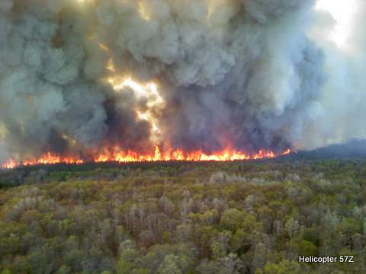
Wildland In Meridian

Slide 2
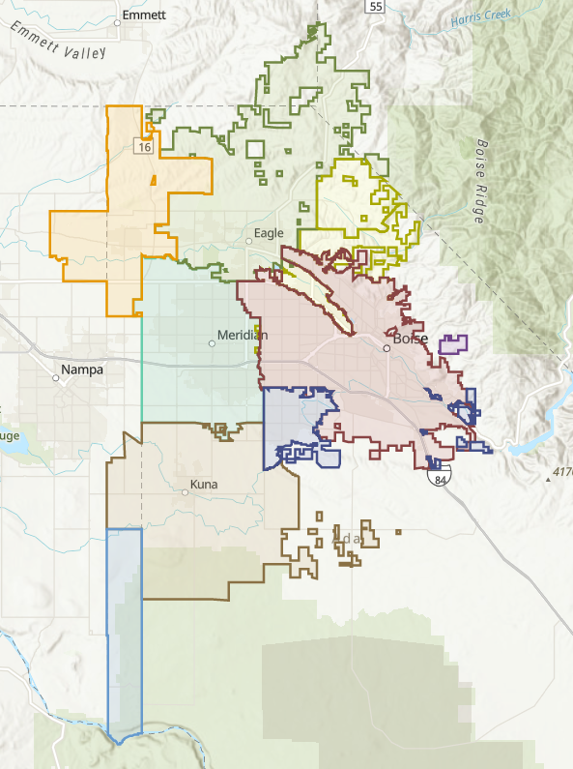
Meridian is Geographically limited and isolated to wildland fires in areas such as open land, ditch banks, and WUI areas in our departments boundaries.

Slide 3
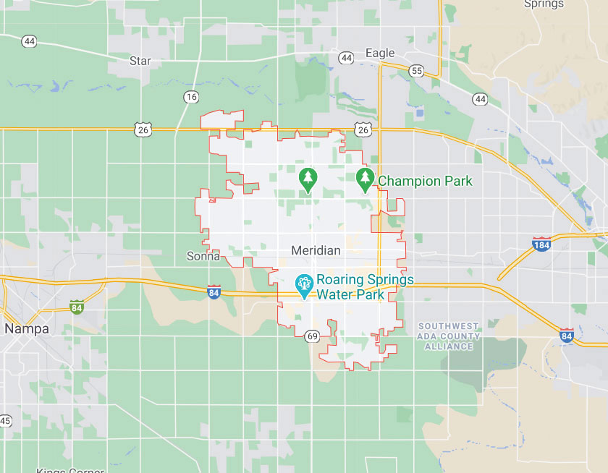
Meridian has automatic and mutual aid agreements with neighboring fire departments when larger fires pose a significant risk to the community, environment and natural resources.
These include not only city resources but federal and state resources as well.
Meridian Brush
Mutual Aid Brush

Slide 4
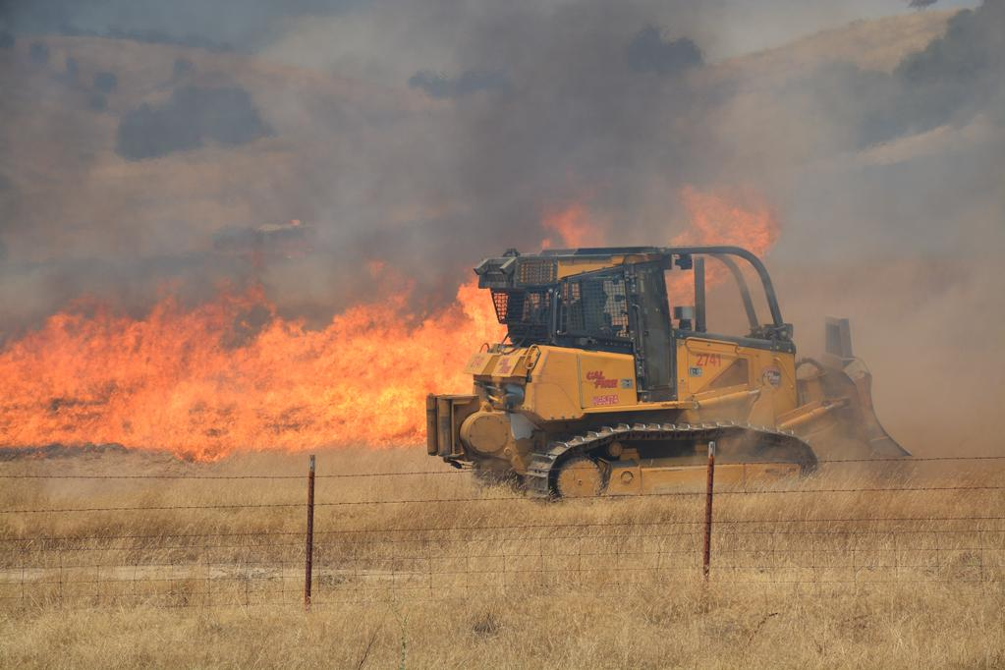
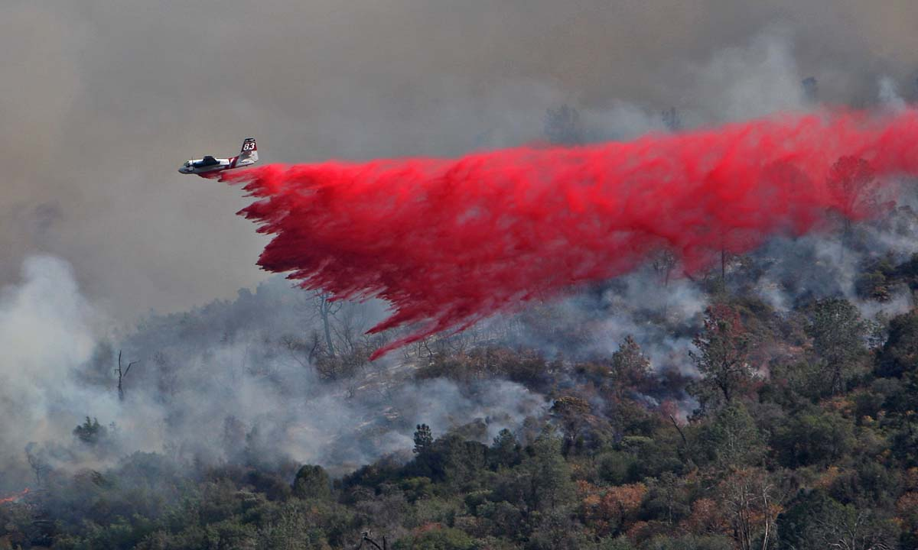
Heavy Equipment and Aircrafts
We have the potential to not only work with different engines, but Dozers and Airtankers and helicopters as well
Even if you and your crew are not directly communicating with the air tankers, ensure you are scanning the proper Air to Ground Frequencies when aircraft are present

Slide 5
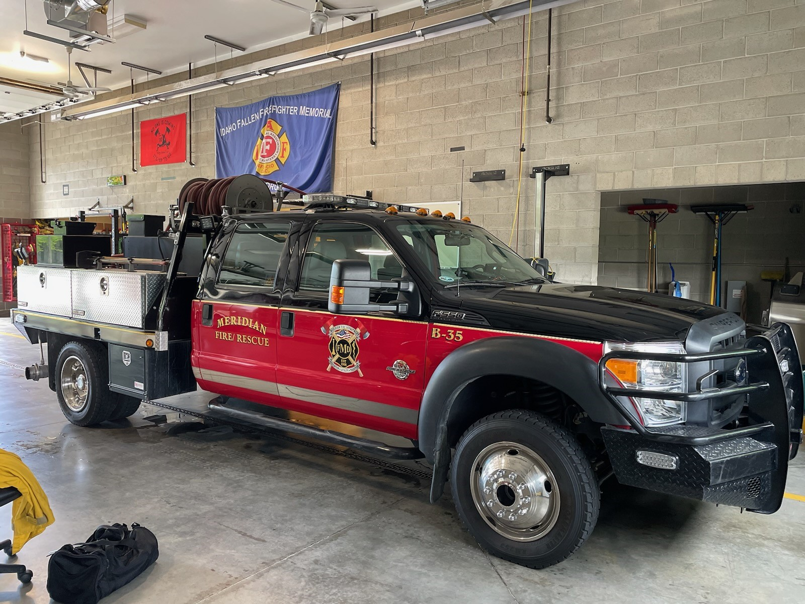
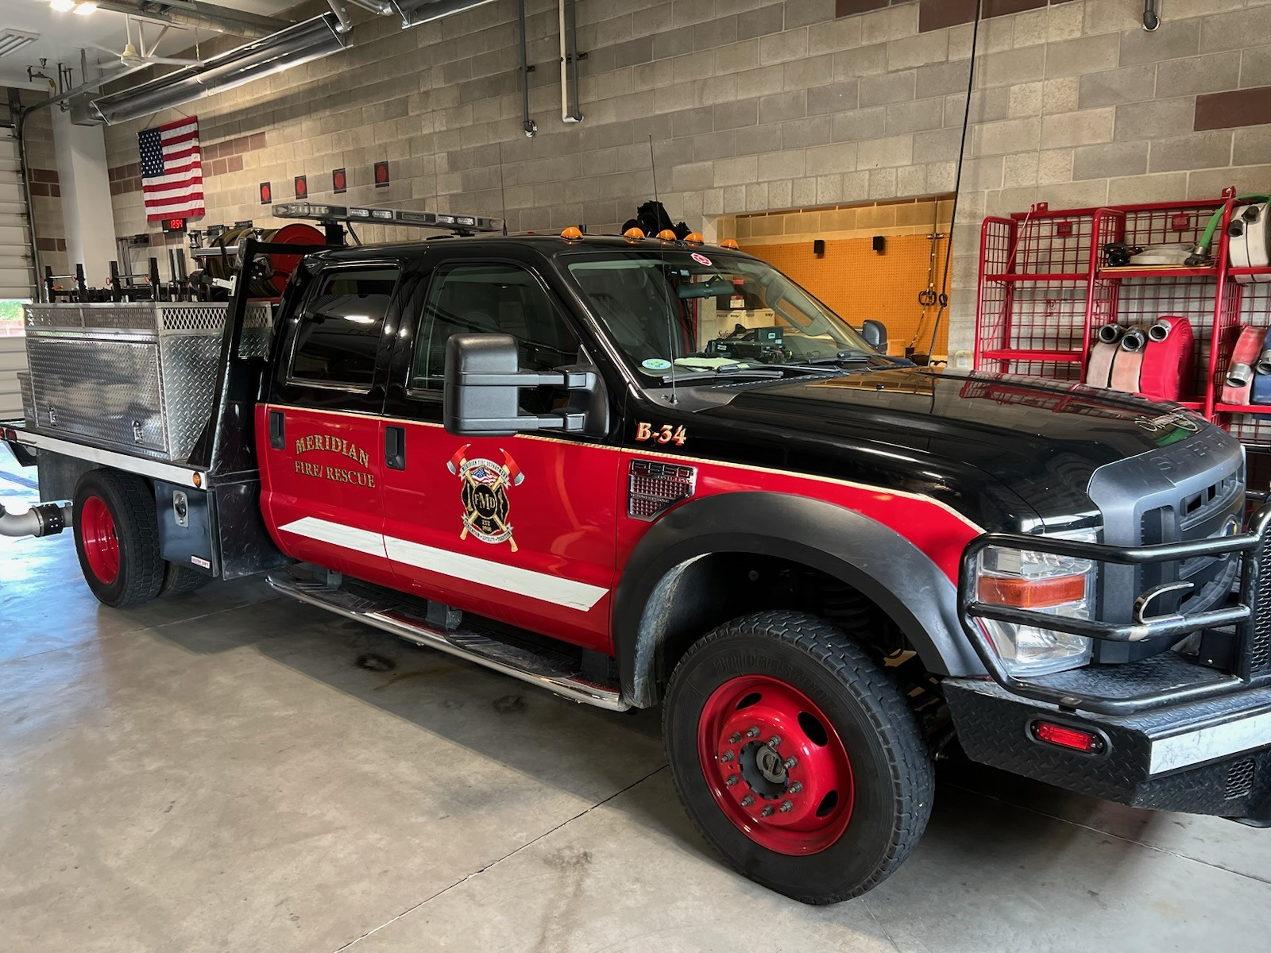
Our Brush Rigs
2 Type 6 Brush Rigs, Each used for pump and roll tactic.

Slide 6
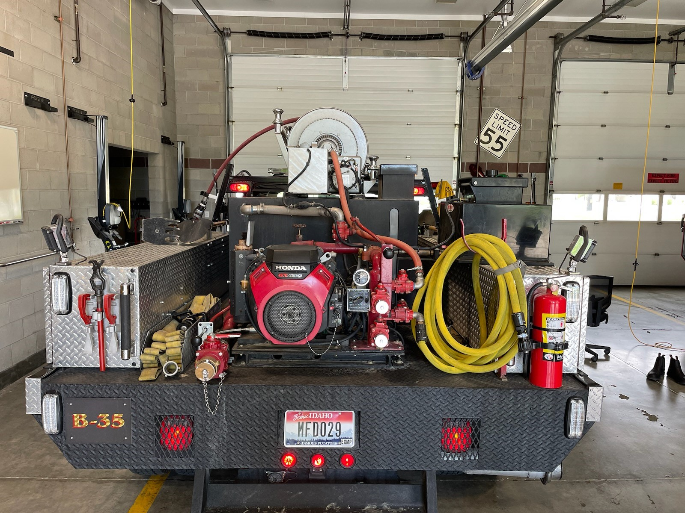
1 Ton or larger pickup truck with a skid mounted unit that has a pump supplied by a 4-cycle motor.
Both Rigs have 300 gallon water capacity as well as class A foam capability and strictly wildland hose.

Slide 7
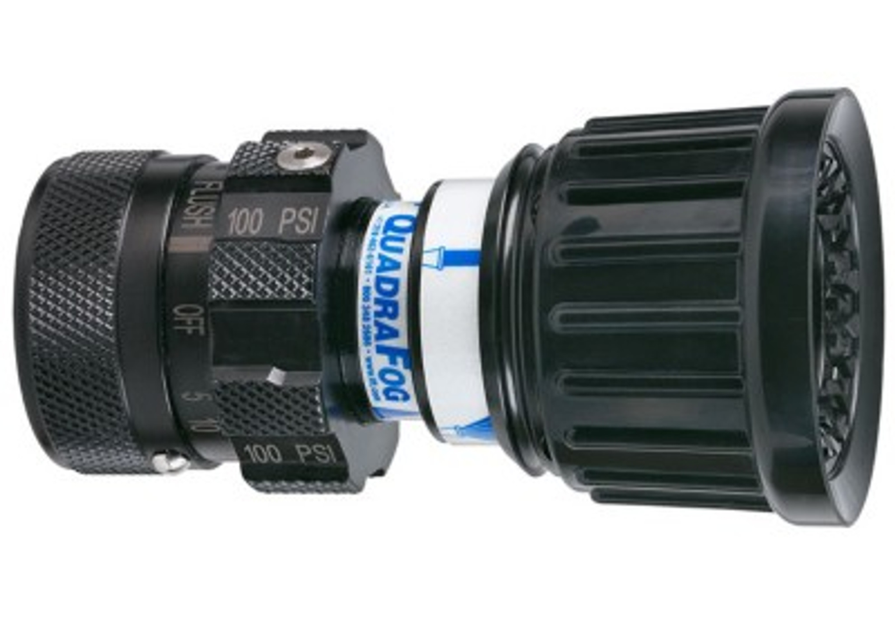
Nozzles
Quadra Fog Nozzle with selectable gallonage.
The nozzles on the brush rig can do 10-24 GPM.
The nozzles on the Structure engine hose packs can do 5, 10, 24, 40 GPM, this is due to the larger tank capacity. Structure engines carry 750 Gallons or more, so water conservation isn’t as much of an issue.

Slide 8
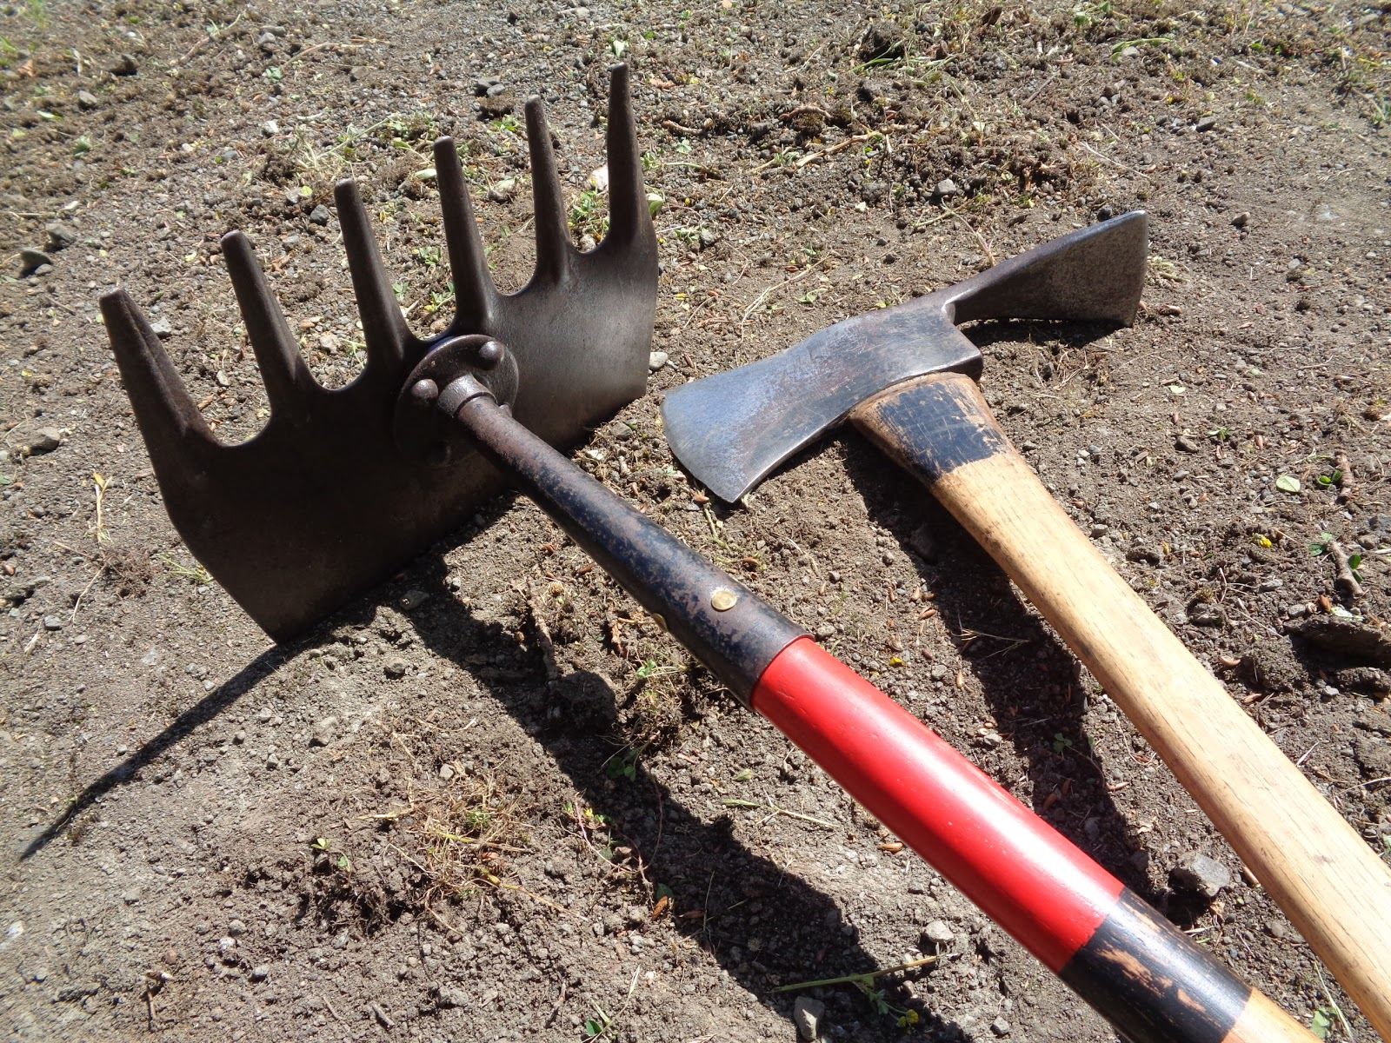
Tools
Our Brush rigs have limited tools, but we do have the ability to dig line.
2 Pulaskis (scraping and cutting)
2 McClouds (Scrapers)
2 Shovels (Digging)
1 chain saw with Wood chain
1 Bolt Cutter to gain access
Multiple Fuzees

Slide 9
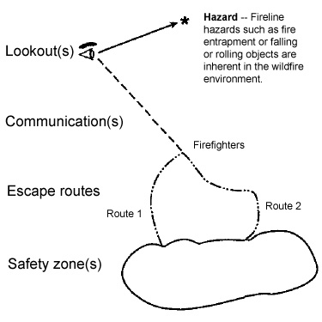
L.C.E.S
L.C.E.S. System is the result of analyzing fatalities and near misses for over 20 years of active fireline suppression duties. NWCG decided that all firefighters should be given an interconnecting view of Lookout(s), Communications(s), Escape routes and Safety zone(s).
LCES is the fundamental safety items that need to be in place before a fire attack may occur.

Slide 10
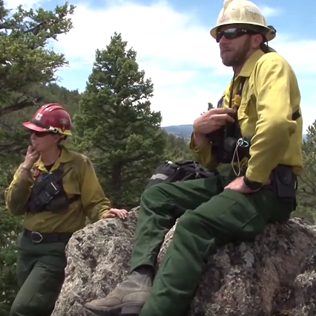
Look Out
The lookout is in a position where both the objective hazard and the firefighters can be seen.
Lookouts must be trained to observe the wildland fire environment and recognize and anticipate changes, relaying with the crews when hazards arise to allow crews to reach their safety zones, or less hazardous areas.

Slide 11
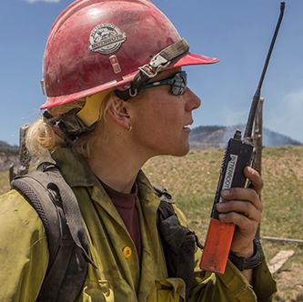
Communication
The Five Communication Responsibilities for all firefighters:
Brief others as needed.
Debrief your actions.
Communicate hazards to others.
Acknowledge messages.
Ask if you don't know.
Everyone on the fire has a role and responsibility in recognizing and communicating hazards.

Slide 12
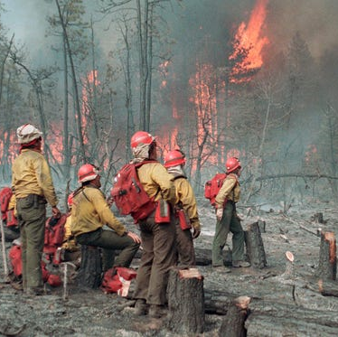
Escape Routes
An escape route is a preplanned and understood route to reach a safety zone.
What are the primary concerns in choosing an escape route?
Select the closest, least obstructed route.
Plan for more than one escape route.
Avoid an uphill escape.
Scout and clearly mark the route for visibility (aids during smoky situations or night operational periods).
Determine escape time — consider slowest person, fatigue, and temperature factors.
Continuously reassess the situation with regard to work progress and additional resource arrivals.
Assure all line personnel are familiar with escape routes.

Slide 13
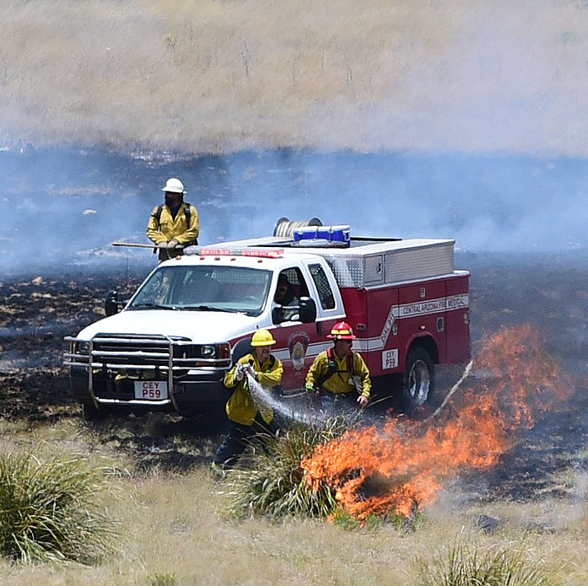
Safety Zones
An area of refuge for crews to be safe without the need to deploy a shelter
Consider fire conditions, number of personnel, slope, vehicles and more when looking for a properly sized safety zone

Slide 14
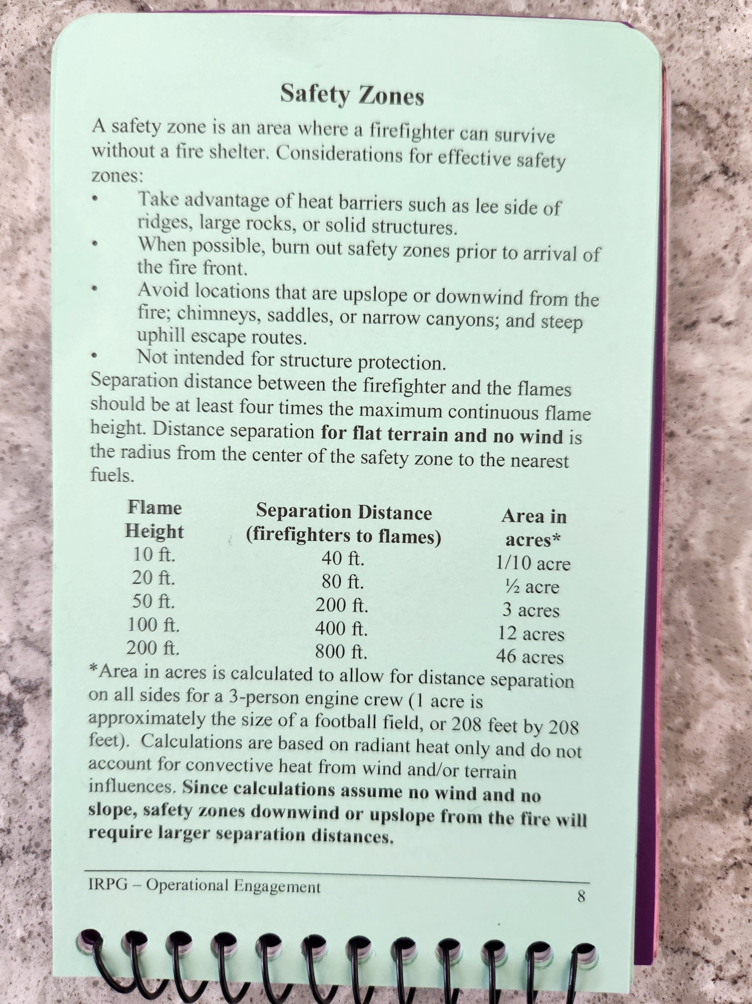
Safety Zone
A Safety zone is NOT a shelter deployment zone
Reminder that recommended safety zones are a minimum recommendation since they are for flat terrain and no wind
Safety zones are for 3 persons and 1 engine, must be adjusted for more personnel and equipment

Slide 15
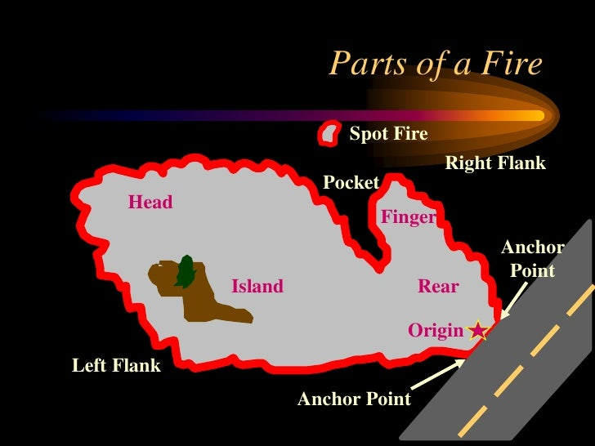
Tactics
“Anchor, Flank and Pinch”
Ensure you have a solid anchor point.
Take right or left flank. This tactic allows you to “take the black with you” so you always have a safety zone.
Look out for islands, pockets, spot fires.

Slide 16
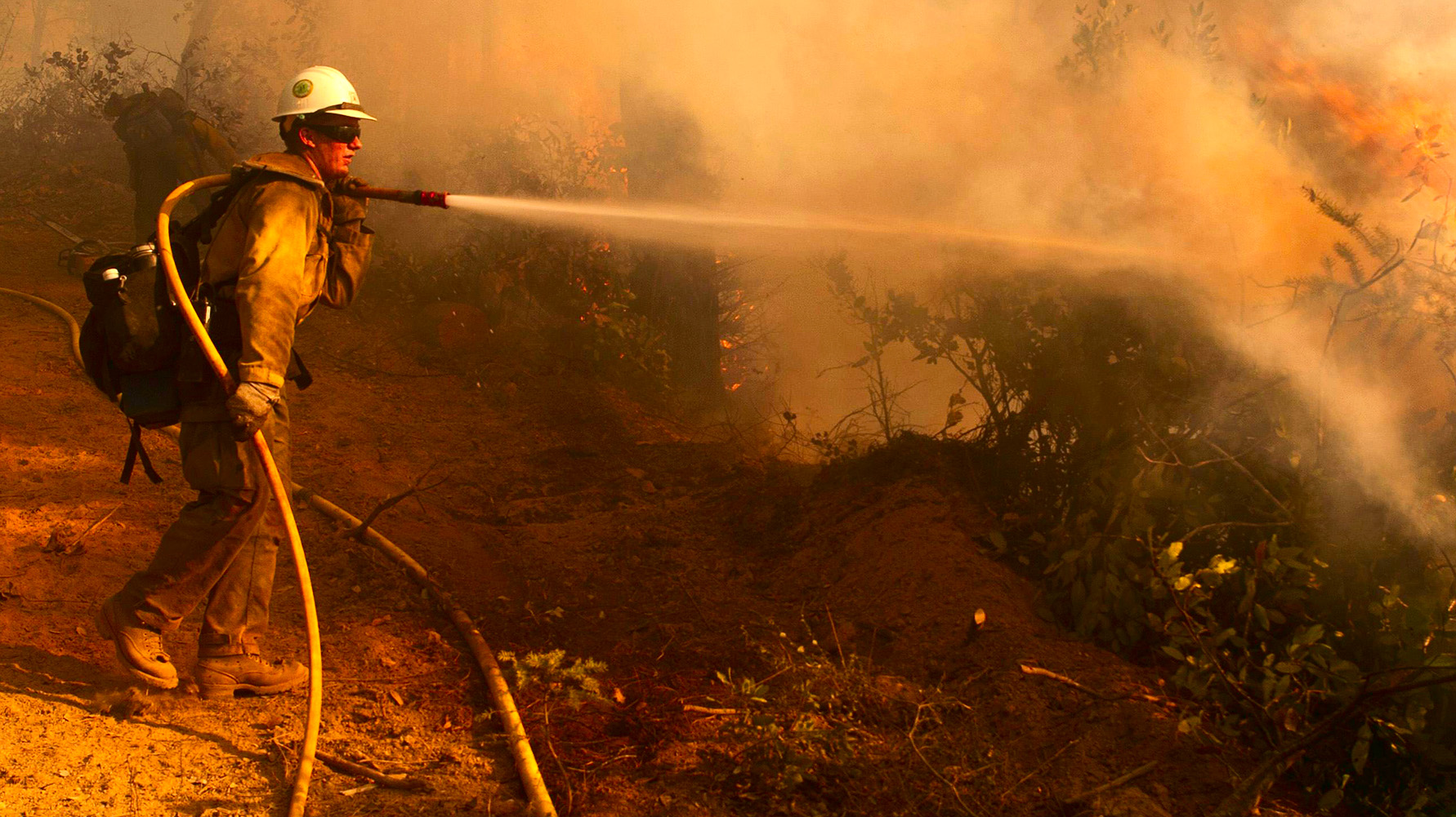
10 Standard Firefighting Orders

Slide 17
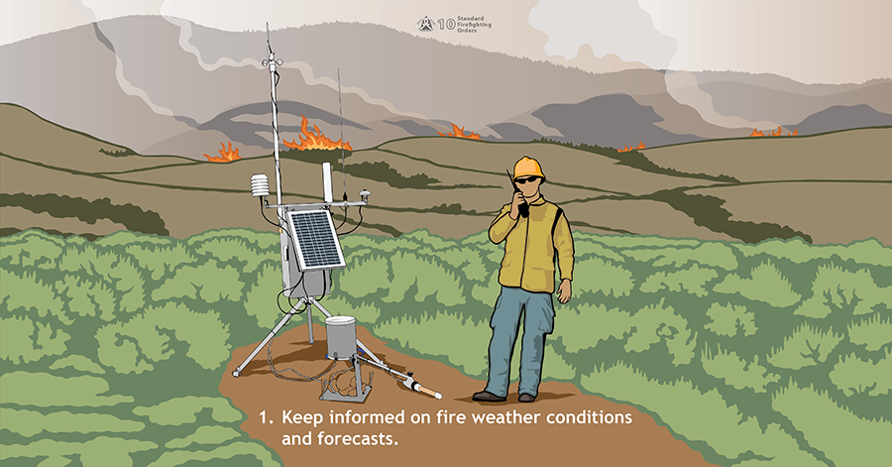

Slide 18
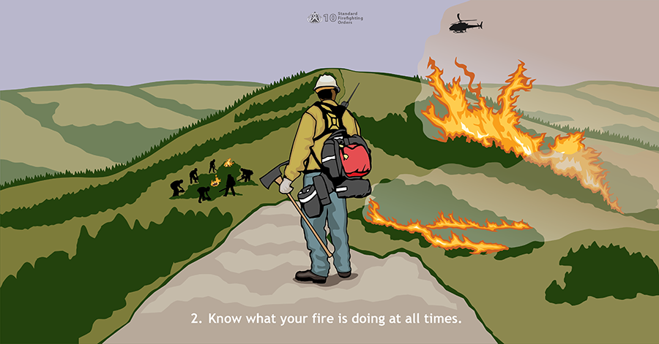

Slide 19
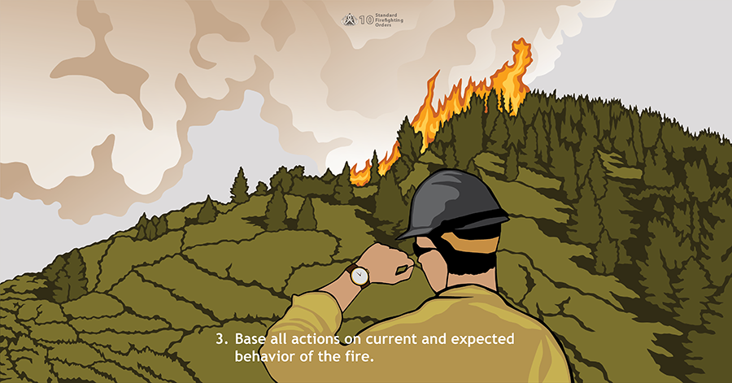

Slide 20
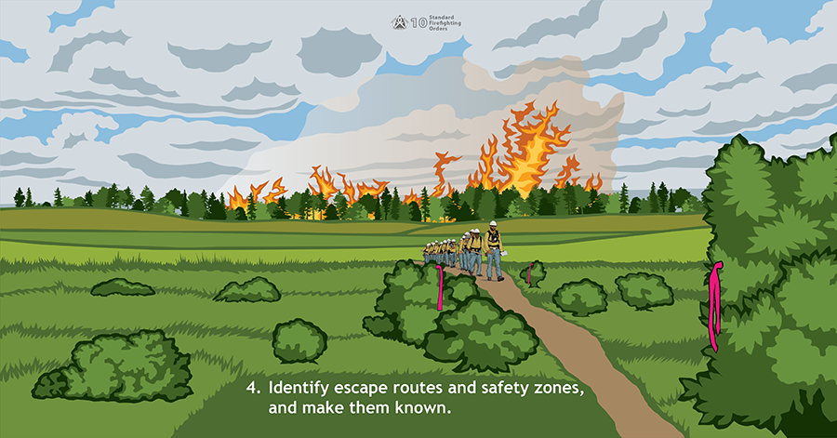

Slide 21
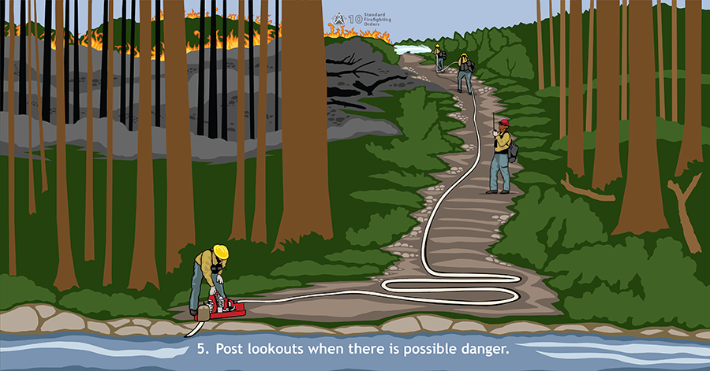

Slide 22
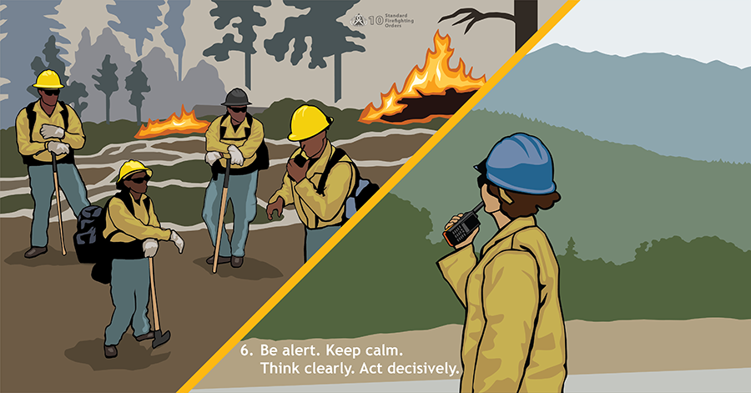

Slide 23
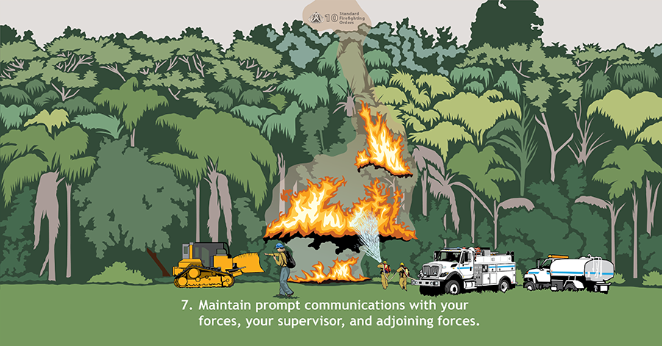

Slide 24
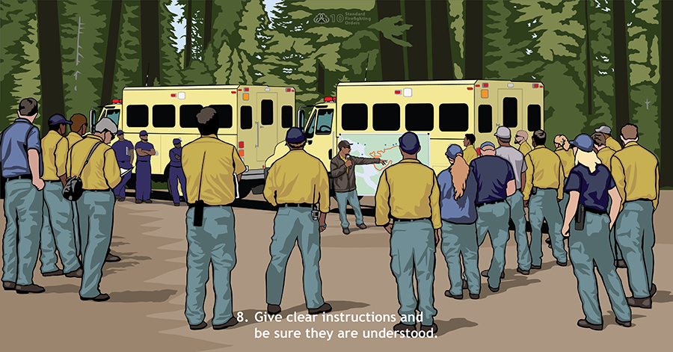

Slide 25
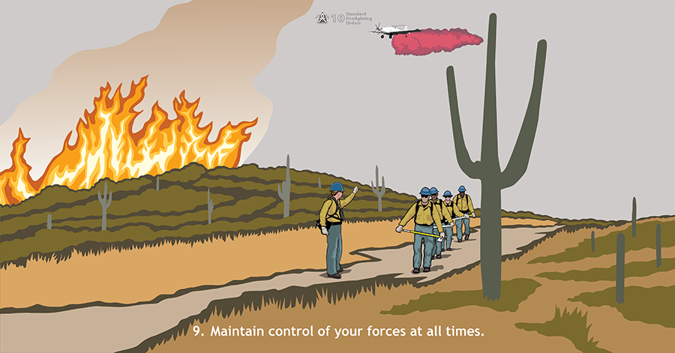

Slide 26
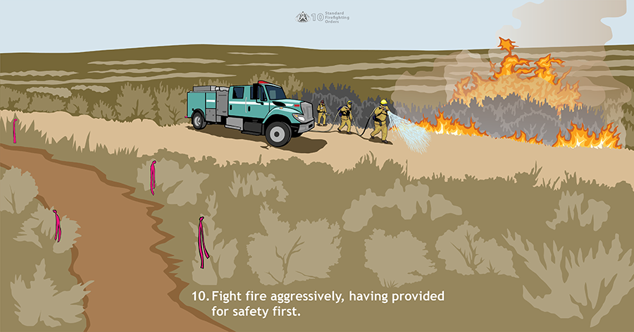

Slide 27
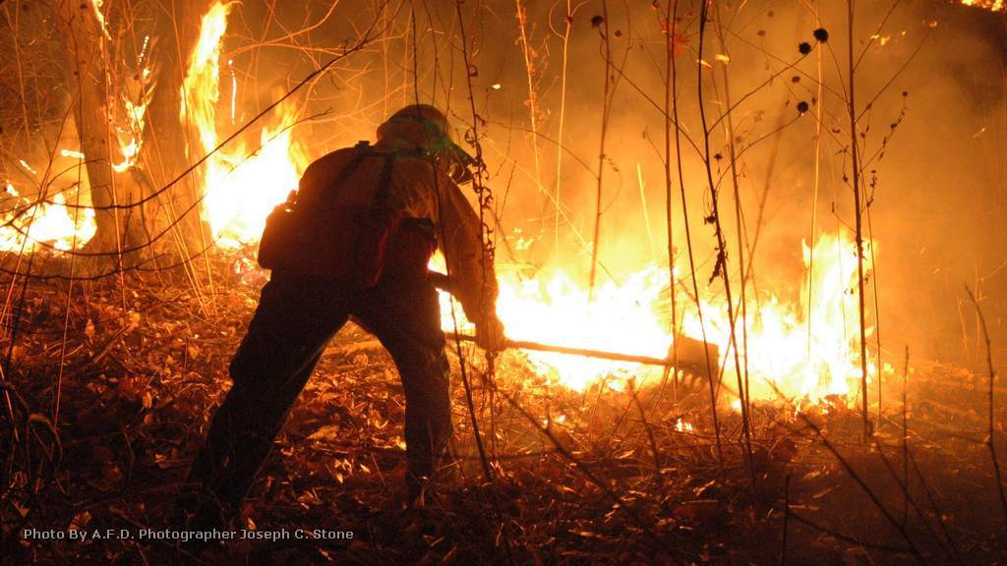
18 Watchout Situations

Slide 28
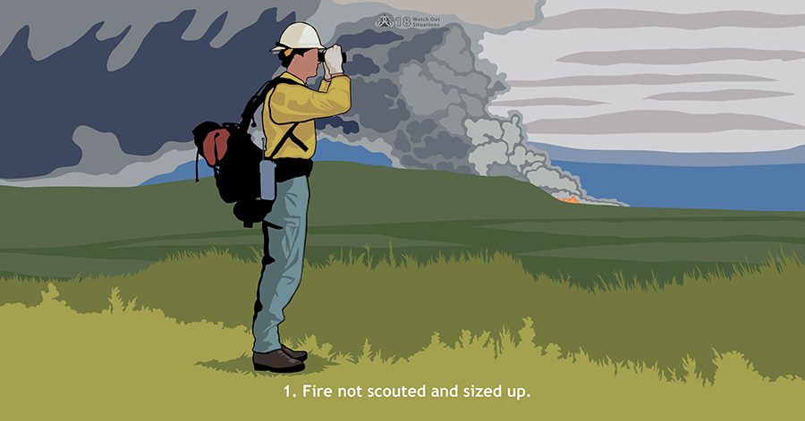

Slide 29
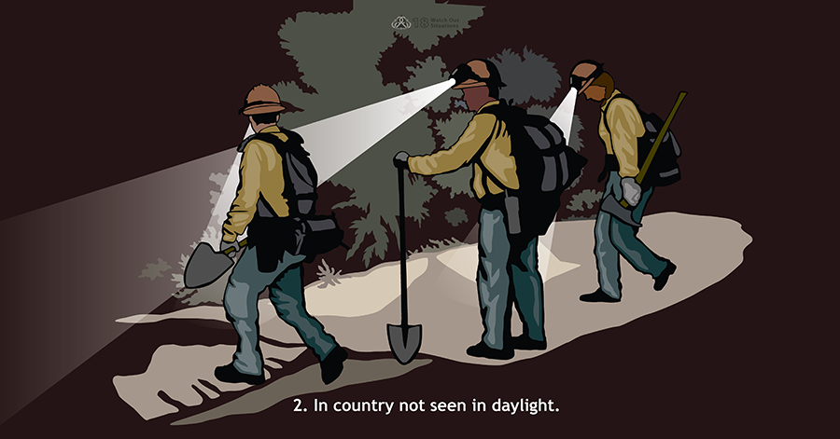

Slide 30
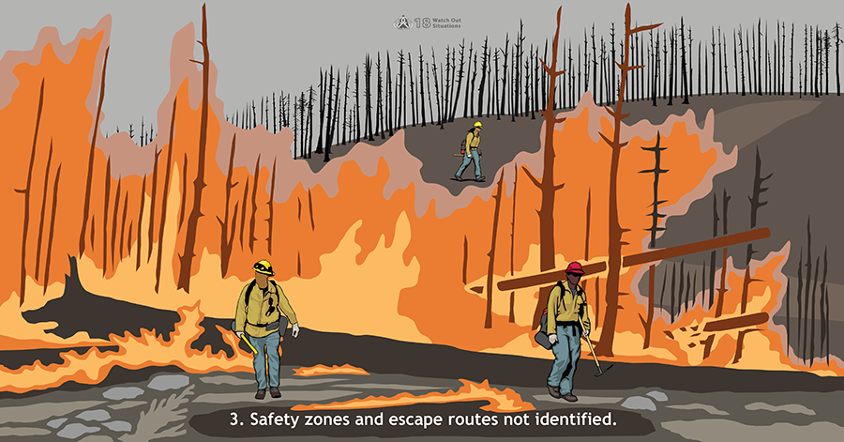

Slide 31
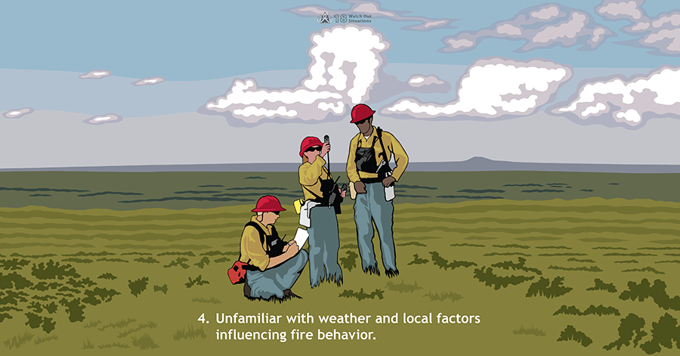

Slide 32
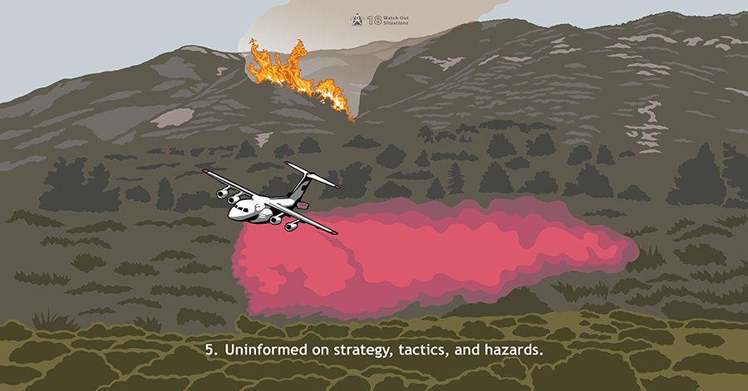

Slide 33
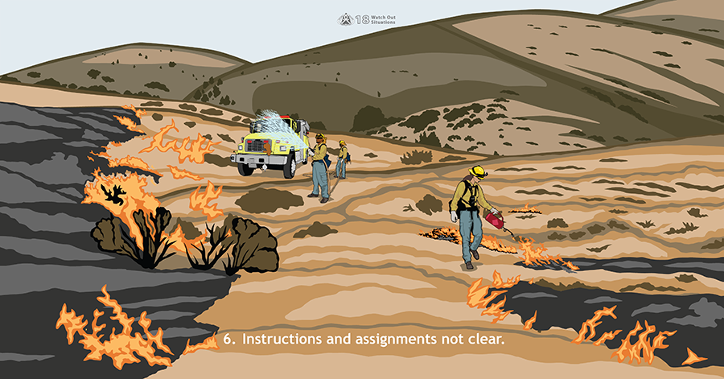

Slide 34
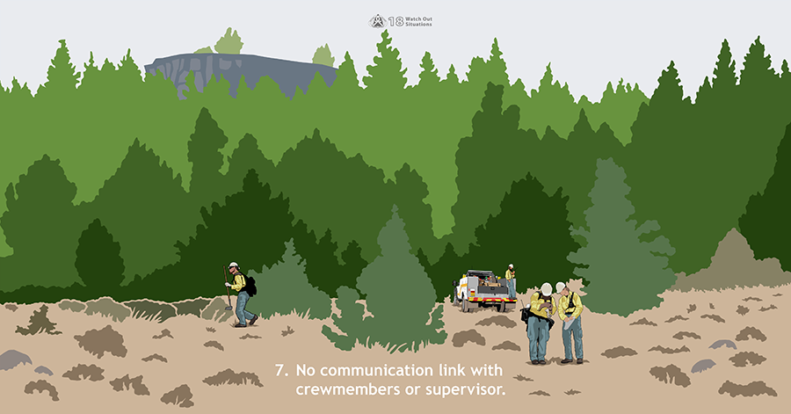

Slide 35
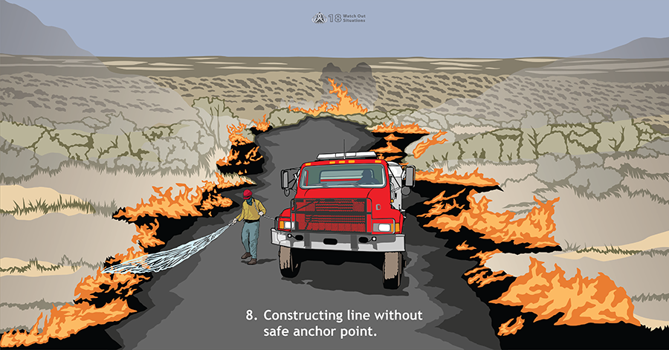

Slide 36
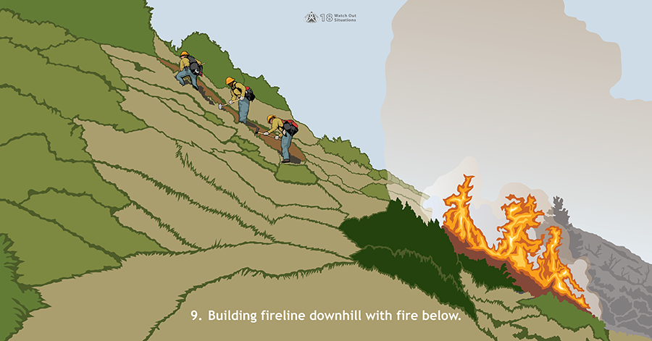

Slide 37
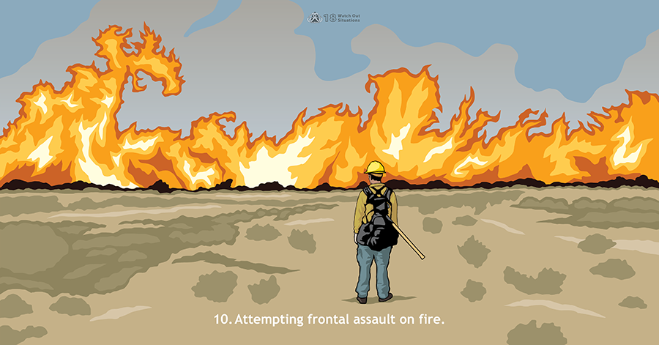

Slide 38
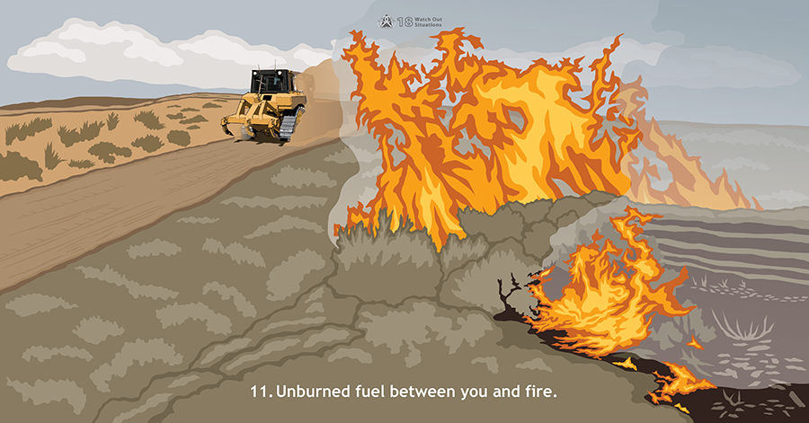

Slide 39
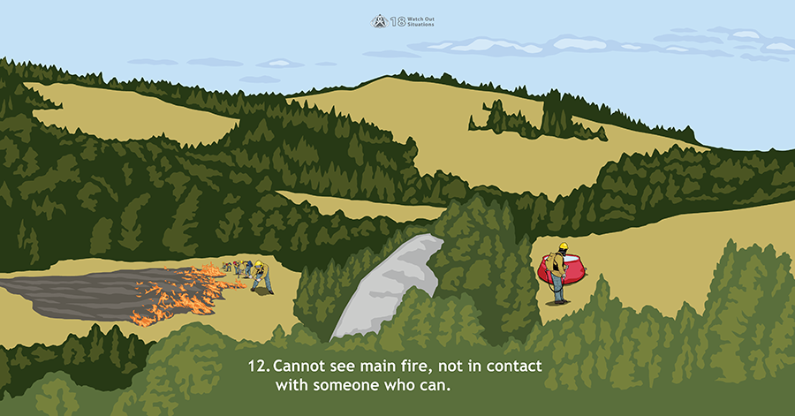

Slide 40
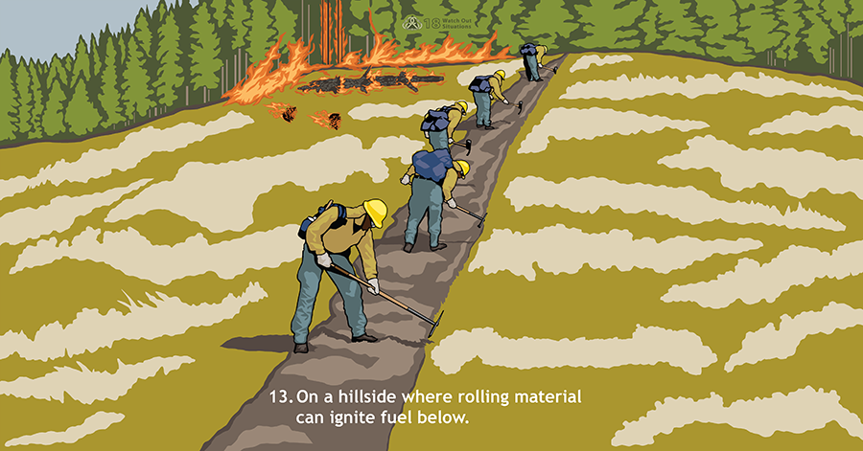

Slide 41
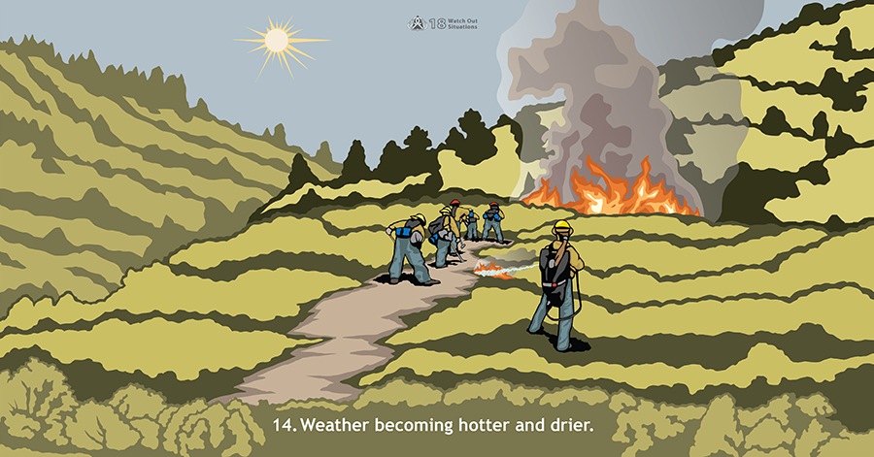

Slide 42
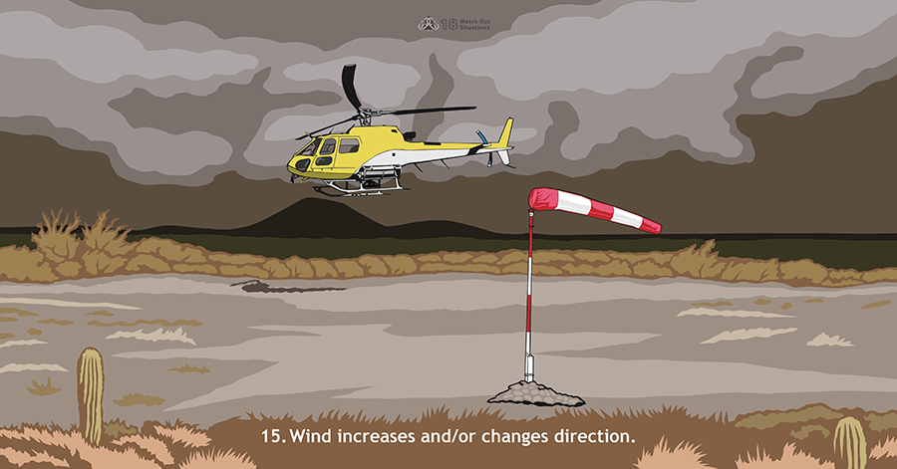

Slide 43
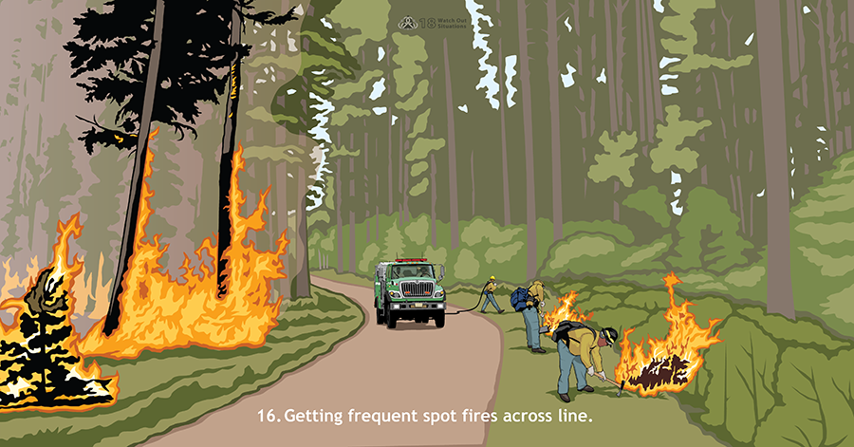

Slide 44
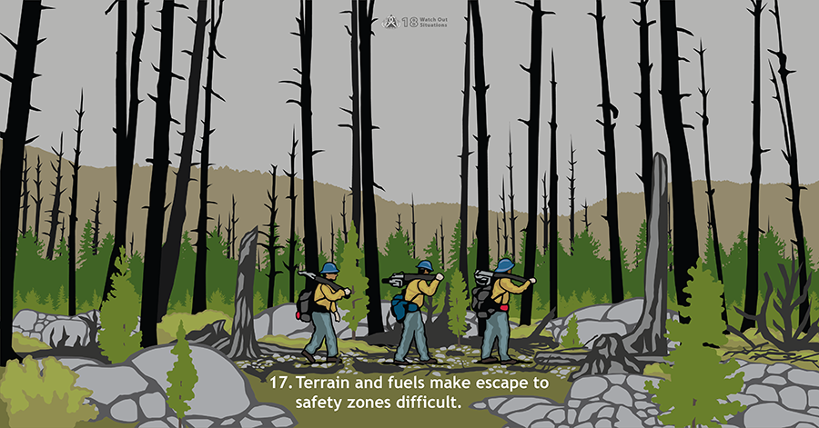

Slide 45
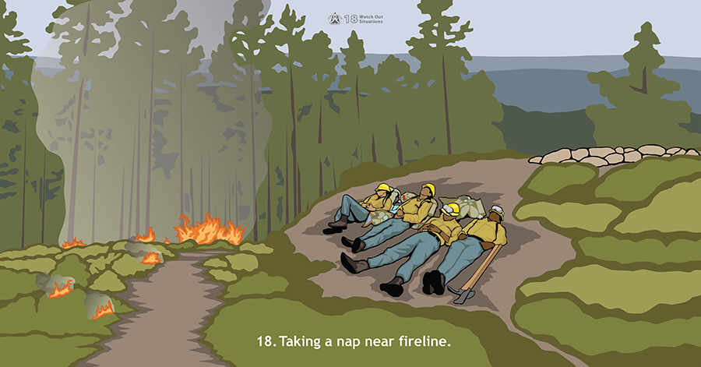

Slide 46
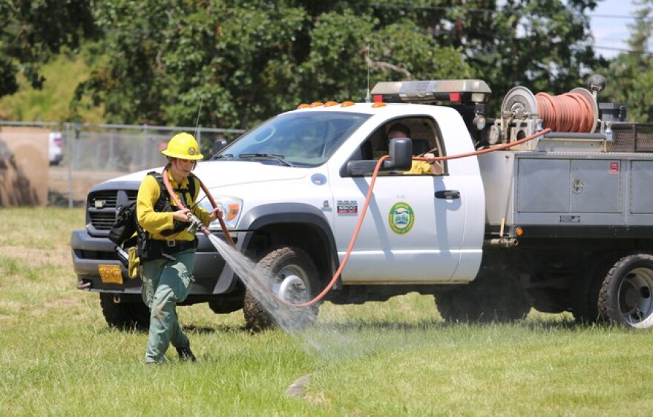
Pump and Roll
Our go to way of fighting wildland fires.
Keeps the engine in the black
Very Mobile and quick
Limitations are topography, Fuels, vehicle clearance etc.

Slide 47
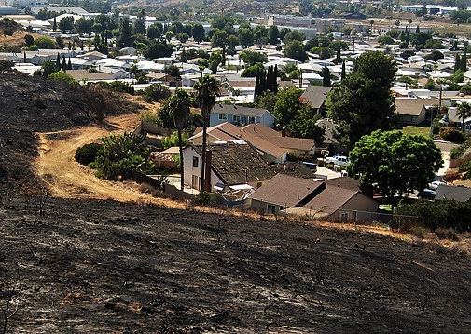
Structure Protection
Stand Alone (Low Risk)
Prep and Hold ( Moderate Risk)
Prep and Go ( High Risk)
Check and Go ( Extreme Risk)

Slide 48
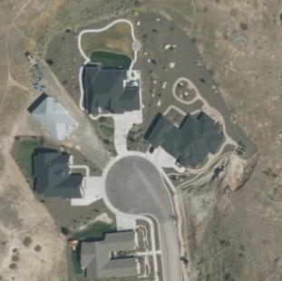
Stand Alone
Safety Zone Present
Requires Little to No action
Will require patrol or homeowner presence after fire passage

Slide 49


Prep and Hold
Possible Prep and Hold
Safety Zone present at or near structure for apparatus and firefighters
Structure has a higher probability of ignition without firefighter intervention
Stand Alone

Slide 50
Prep and Hold
Possible Prep and Hold
We can only do what time allows, and cannot devote our resources for too long to one home, quick Prep can include;
Moving and re-stacking woodpiles to safe locations
Weed whacking to a height of 6 inches or less
Limbing low hanging branches within the defensible space
Remove debris accumulations from the defensible space
Limb branches that overhang the roof if accessible
Stand Alone

Slide 51

Prep and Leave
No Safety Zone Present
If time allows, rapid mitigation, apply foam or gel
Set trigger point for safe retreat
Go to the nearest safety zone, return to area after fire passage

Slide 52

Prep and Leave
No Safety Zone Present
If time allows, rapid mitigation, apply foam or gel
Set trigger point for safe retreat
Go to the nearest safety zone, return to area after fire passage

Slide 53

Check and Go!
Check for lives and Go!
No safety Zone present
Inadequate time for mitigations
If time allows ensure lives are not threatened
Set trigger point for safe retreat
Go to nearest safety zone, return to area after fire passage

Slide 54

Our Hose Packs

Slide 55
3 bundles of 100 ft 1” hose.
First bundle indicated with a red strap has the nozzle.
One Hose Clamp.
One 1 ½” to 1” NH reducer.
One

Slide 56

Three Ways to Deploy Hose packs
Can be added onto the 200ft Booster line, this requires no additional adapters or hardware. A hose clamp is in the pack to allow you to extend each section.

Slide 57

Three Ways to Deploy Hose packs
Extend off of an 1 ¾” preconnected line. This is especially useful in a structure protection setting. This provides an opportunity to increase the deployment length of the hose and provide a lighter-weight hose option for fire attack.
This may be used to help with longer setbacks where the 1 ¾” is a “trunk” or “supply” line
This deployment does require a 1 ½” to 1” NH Reducer located in the pack. Connection can also be made from the bale of a nozzle.

Slide 58

Three Ways to Deploy Hose packs
Used as a dedicated hose deployment straight from the pump
This can provide many options or as an additional wildfire attack line when the booster is already in use.
This Deployment requires using the 1 ½” to 1” NHT reducer located in the pack

Slide 59

Deployment
The best practice is for the pack to be carried by the company officer, this allows for the firefighter on the nozzle to focus on the fire attack and reduce fatigue in the firefighter doing most of the physical work. In some cases, the company officer may assign the firefighter to carry the pack

Slide 60
Video on How to deploy hose pack can be found on intranet P: drive

Slide 61
Video for Re-Packing Hose Pack can be found on Intranet P: Drive

Slide 62

Shelter Deployment
Emergency effort at survival, used when you cannot make it to a safety zone.
Clear Brush around you or find a good spot to deploy, ensuring you can get a good seal on the shelter
Position so your feet are towards the fire.
If multiple people, get to where you can communicate with each other. Consider bringing a radio to communicate with others.
If absolutely necessary, up to two people can use one shelter

Slide 63

Click Video to watch

Slide 64


